Slide 1
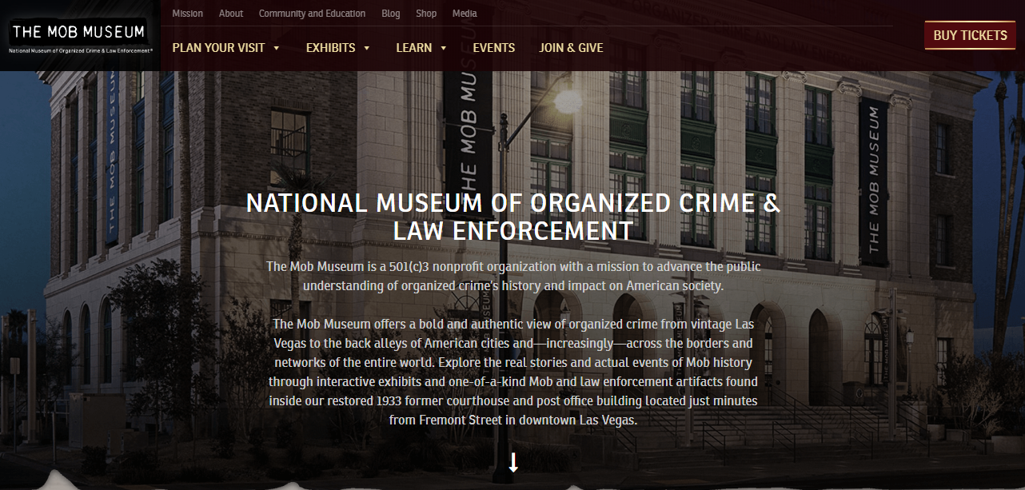
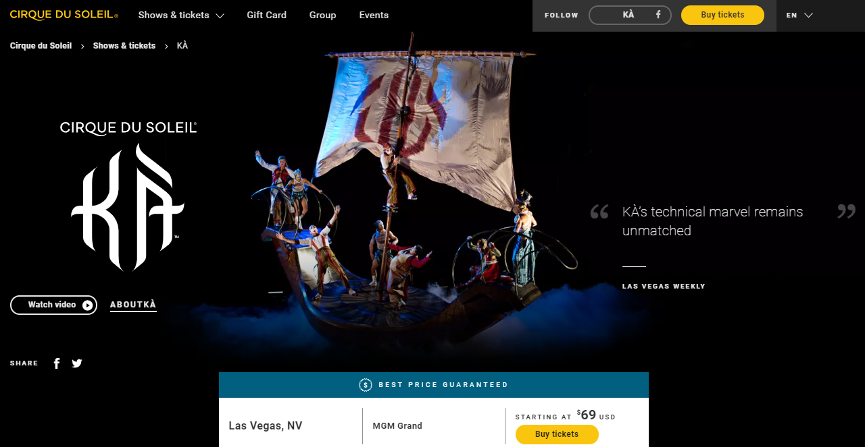
KÀ: The glory of battle, the rush of victory Gravity defied, enemies confronted, noble combat becomes acrobatic. War has never been fought this way. A colossal, moving stage is the battlefield. Up is down, land becomes sky. These dimension-bending confrontations redefine what it means to fight. Bodies full of strength, glowing with light and heat. Minds as bright and clear as the vast heavens, the great ocean, and the highest peak. Determination is the path, victory the reward. Dare to be part of the battle, live at MGM Grand, Las Vegas. Book now!

Slide 2
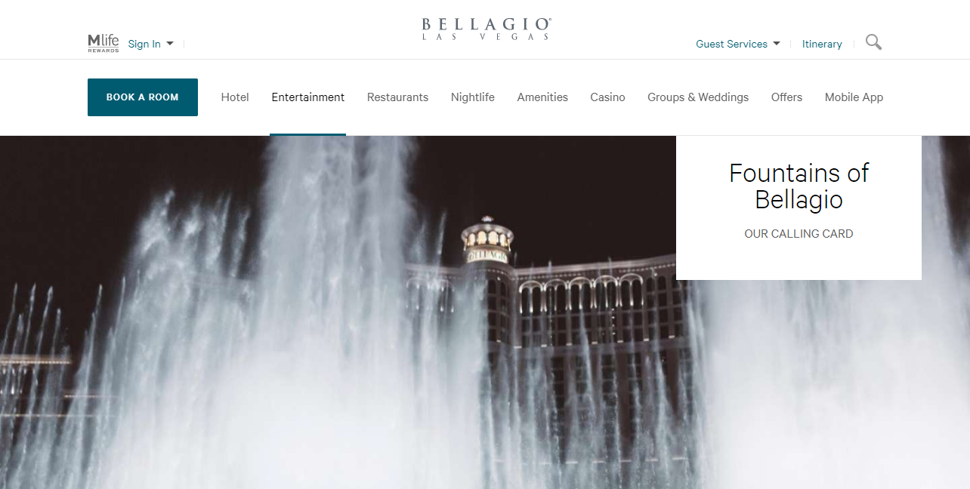
The Icon in Action There is nothing like seeing them in person. The Fountains of Bellagio were destined to romance your senses. Take in a spectacular show of thoughtfully interwoven water, music and light designed to mesmerize its admirers. It is the most ambitious, choreographically complex water feature ever conceived and it’s absolutely free for any visitor to enjoy. Step back, or find a comfortable perch to sit, and watch the dynamic performance set against the backdrop of the Las Vegas lavender sky. Each performance is unique in expression and interpretation so no matter how many times you have seen the Fountains, they always have more in store to wow you with. Fall in love with this unprecedented aquatic accomplishment as you enjoy an enchanting concert of opera, classical, Broadway and pop tunes.

Slide 3
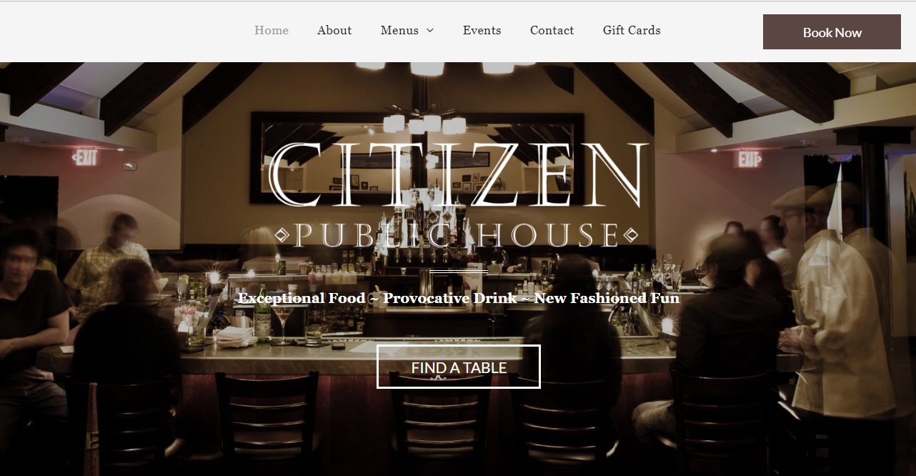
Our Public House This is our version of a contemporary public house, fully equipped with an inviting staff, an energetic centerpiece bar, and vintage black & white family photos hanging on the walls of our warm and comfortable dining room. We're dedicated to the craft of food and beverage. Mixologists pour barrel-aged libations throughout Social Hour, and stir classic cocktails nightly. Meanwhile, the kitchen prides itself on serving exceptional new-American comfort food; dishes derived from distinctly foreign places, yet recipes we now call our own.

Slide 4
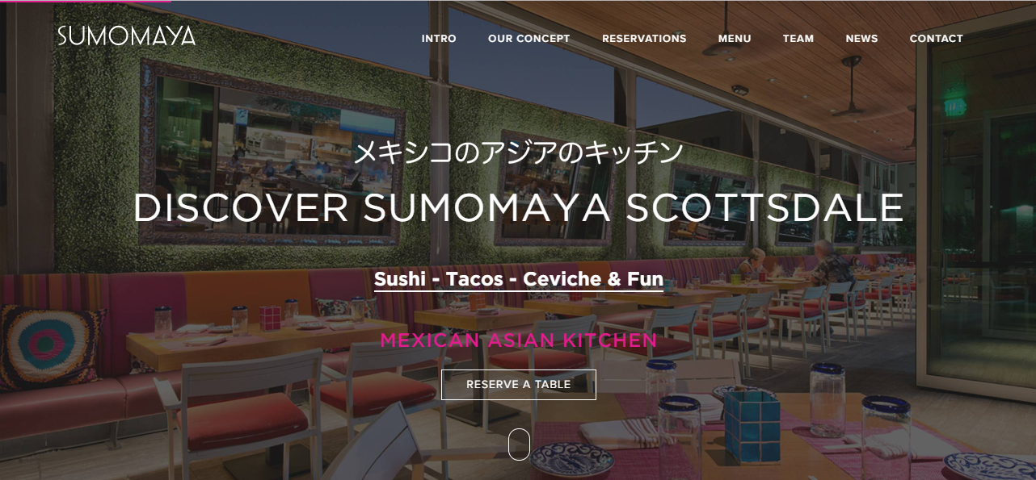
THE CONCEPT SumoMaya combines the magnificent flavors of Asia with the robust culinary traditions of Mexico and essences of South America into a dynamic fusion concept featuring craveable tapas-style plates. At SumoMaya we celebrate the distinctive Mexican and Asian flavors with our unique, seasonal fusion cuisine. Come with us as we travel through these regions on a chef-driven culinary adventure. The Chefs recommend you choose three to five dishes each to enjoy on your own, or share with the table, in order to maximize your experience. Our unique free-form dining style is designed to heighten and arouse your senses.

Slide 5
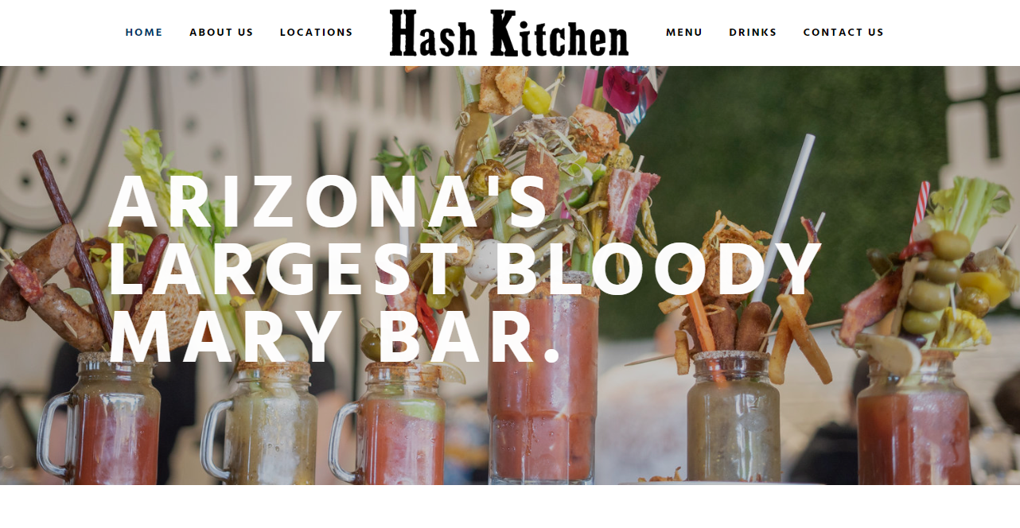
TURNTABLES + MIMOSAS + BLOODY MARY'S + CRAZY BRUNCH MENU #HASH #HASH BABY Hash Kitchen is a creative a.m. eatery that boasts a social dining experience and is designed to be the go-to spot for locals and a culinary destination for visitors.

Slide 6
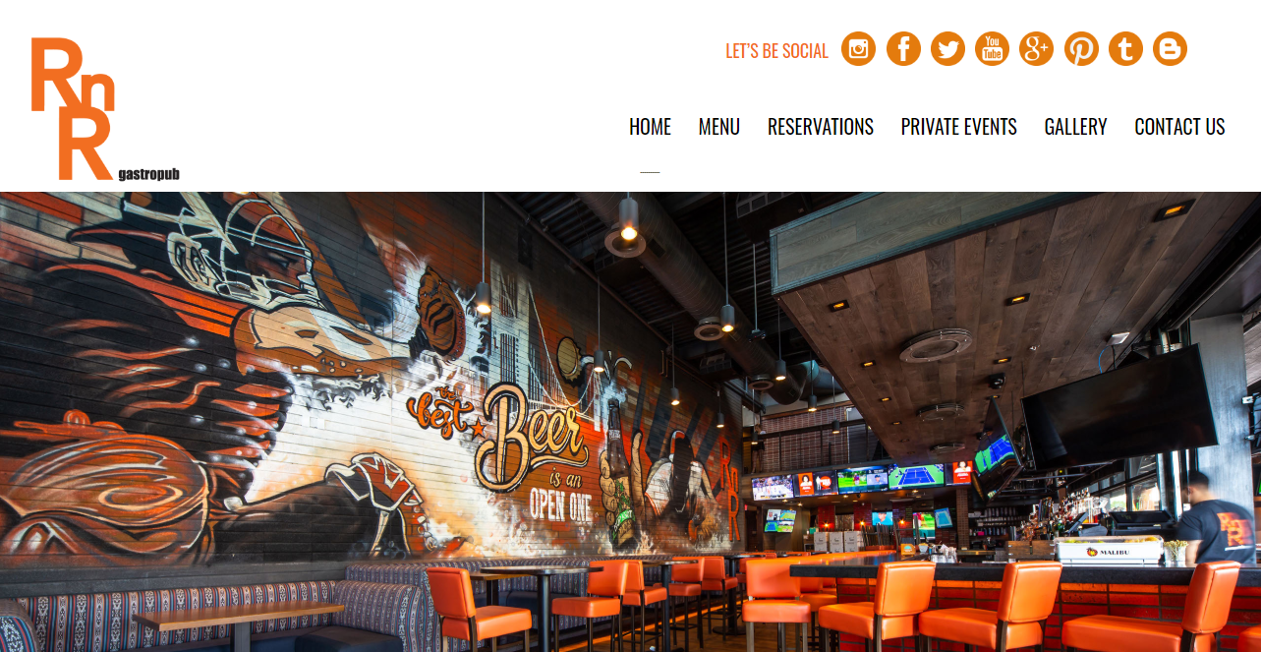
RESTAURANT & BAR RnR has been providing our neighborhood of Old Town Scottsdale with quality American comfort food since 2010. We’ve got the classics that keep you coming back as well as re-imagined staples you’ll be glad you tried. If you're looking for an awesome bar experience - you've found one. Our hand-crafted cocktail menu was created by talented mixologists to satisfy a variety of tastes and our wine and beer menu has options for everyone.

Slide 7
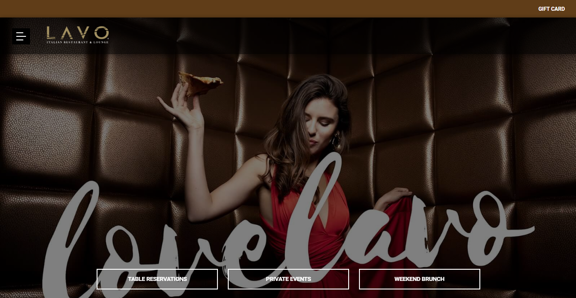
LAVO Italian Restaurant & Lounge is one of the hottest spots on the Las Vegas Strip from the creators of TAO Asian Bistro, TAO Nightclub & TAO Beach. Located at The Palazzo, LAVO has become Las Vegas’ celebrity haunt that has already hosted a long list of star studded evenings.

Slide 8
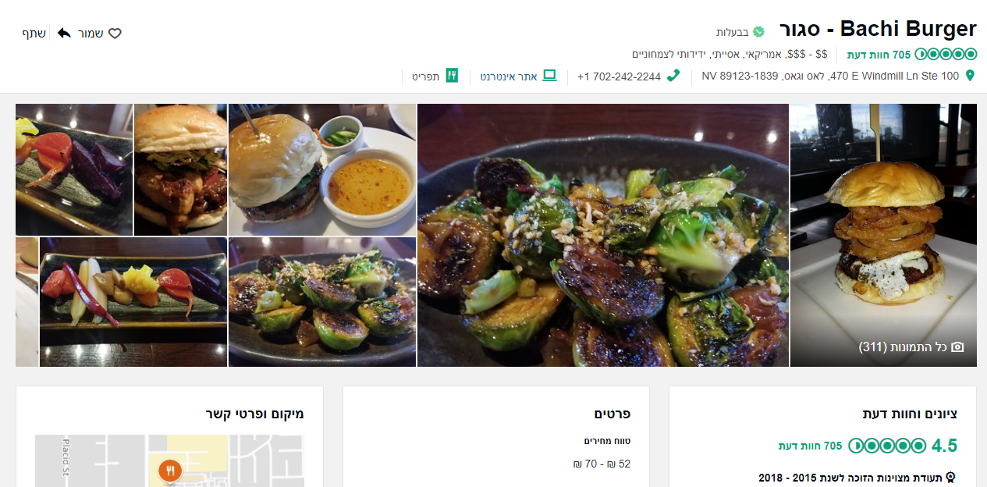

Slide 9
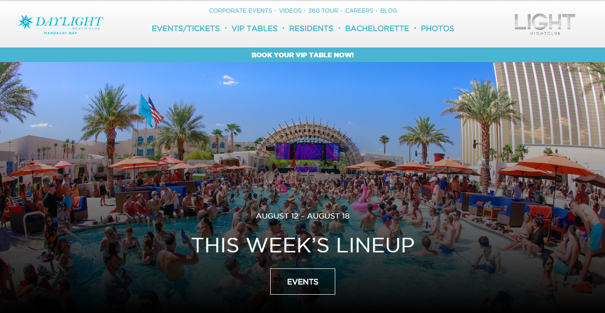
DAYLIGHT Beach Club, the most sought-after Las Vegas dayclub destination on the iconic strip, returns for 2019! This season you’ll be see jaw-dropping performances from Grammy-nominated artist Rick Ross, and super-producer and DJ Duke Dumont. Week after week, artists such as Jeezy, Morgan Page, DJ OoKay, and London On Da Track will give electrifying performances in the 50,000 square foot open-air entertainment venue.

Slide 10
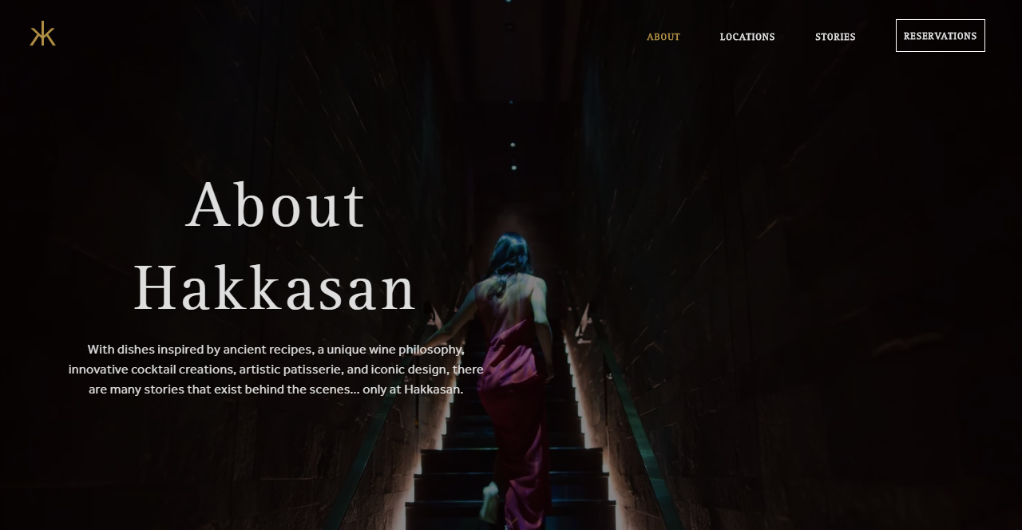
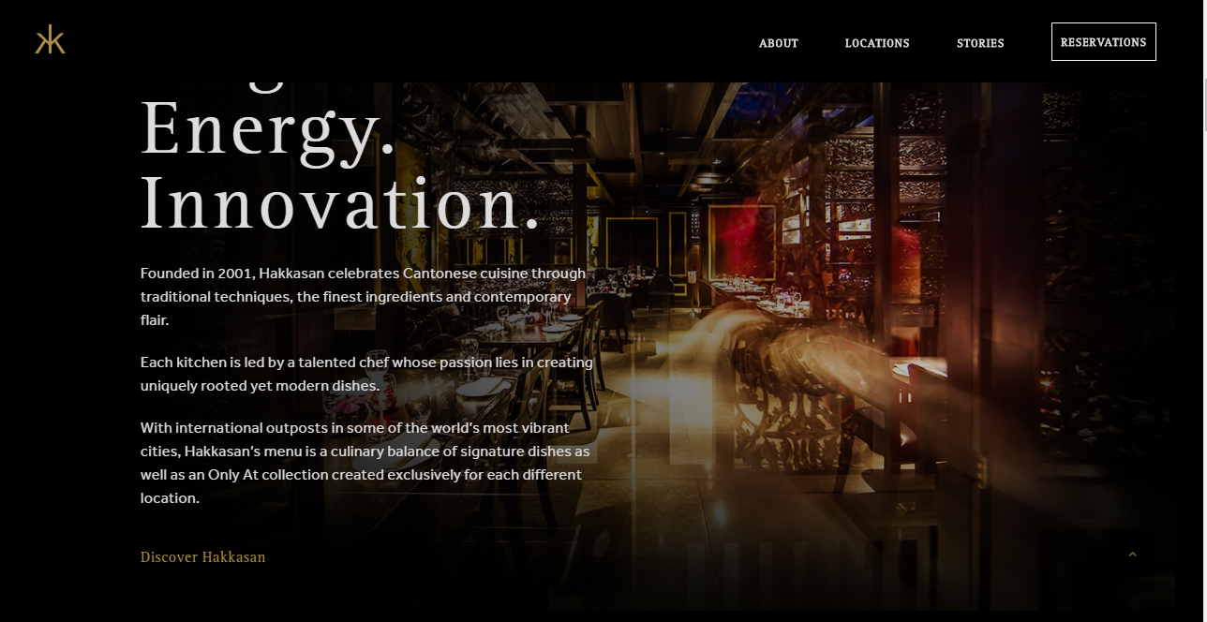
About Hakkasan Modern Cantonese cuisine, world-class mixology and dramatic design. Hakkasan is an award-winning restaurant which uses the finest ingredients and expert traditional techniques to create timeless yet innovative signature dishes.

Slide 11
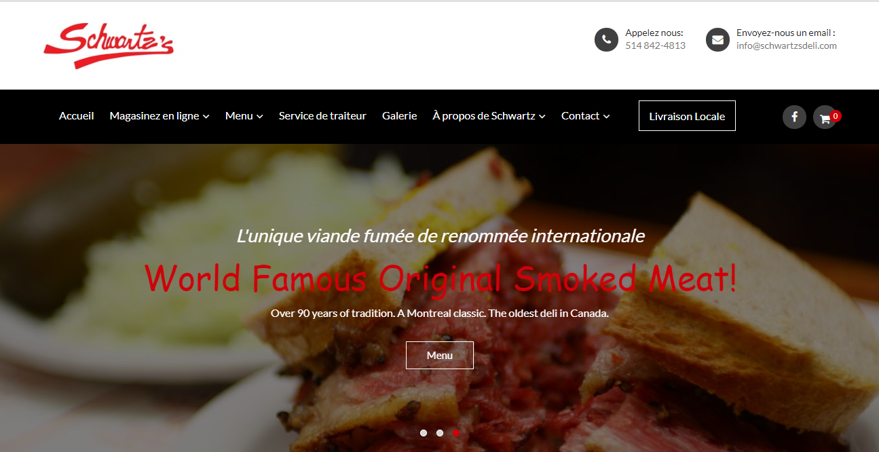
Famous Original Smoked Meat! Over 90 years of tradition - A Montreal classic. The oldest deli in Canada. A true Montreal landmark situated on the historic "Main".

Slide 12
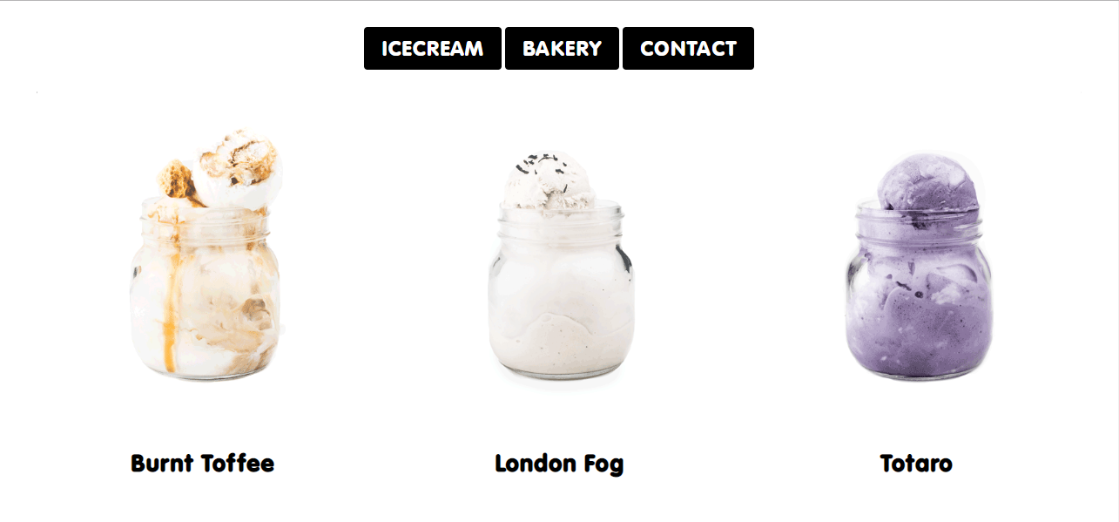
Bang Bang Ice Cream & Bakery

Slide 13
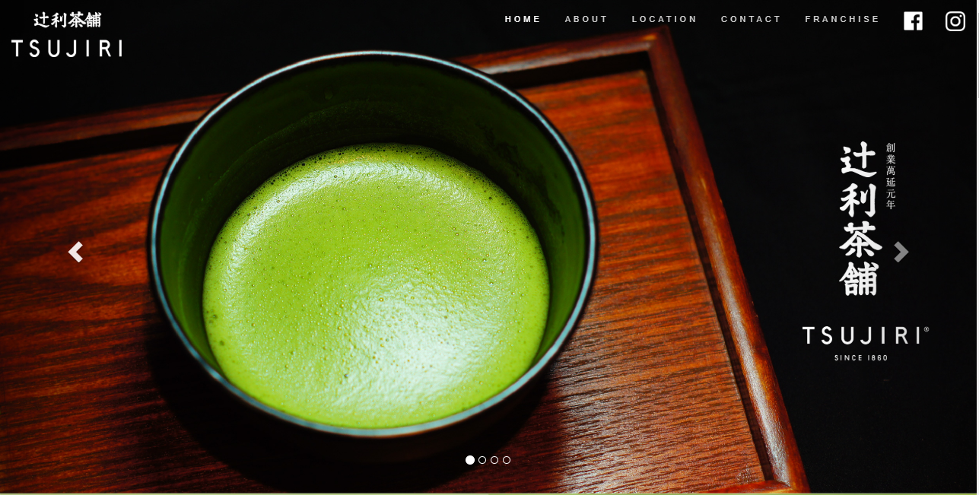
TSUJIRI was founded in 1860 by Riemon Tsuji who was renowned for his spirit of “YUWA”, meaning "continue to innovate and sustain the tradition". His statue was built in Kyoto, Japan to honour his contribution to the Japanese tea industry. Mr. Tsuji has refined the cultivation of Gyokuro (the highest grade of Japanese green tea) and his method is still being used to this day. He is also the inventor of the tea box that preserves the longevity and freshness of the tea leaves during transportation, making fresh tea from Kyoto available to other Japanese cities a century ago. In 2010, CHAHO, which means tea shop in Japanese, were first established outside of Japan to carry on our founder’s spirit and to serve fresh tea to our customers worldwide.

Slide 14
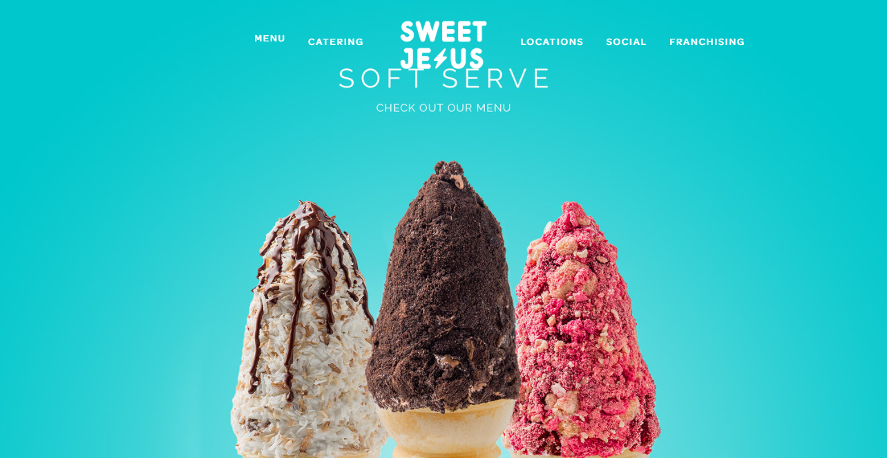
SWEET JESUS…that is good! These were the words that were used to describe the experience when tasting our hand crafted, chef inspired, pimped out ice cream treats in our test kitchen. As a result, the brand Sweet Jesus was born out of a love for experimentation. As leaders in the confectionery game, the goal is to combine conceptual thinking with high-quality ingredients and products, in an effort to make something that tastes and looks, unlike anything you’ve ever seen and had before. Toronto born and globally grown; Sweet Jesus is the little ice cream shop that wouldn't quit.

Slide 15
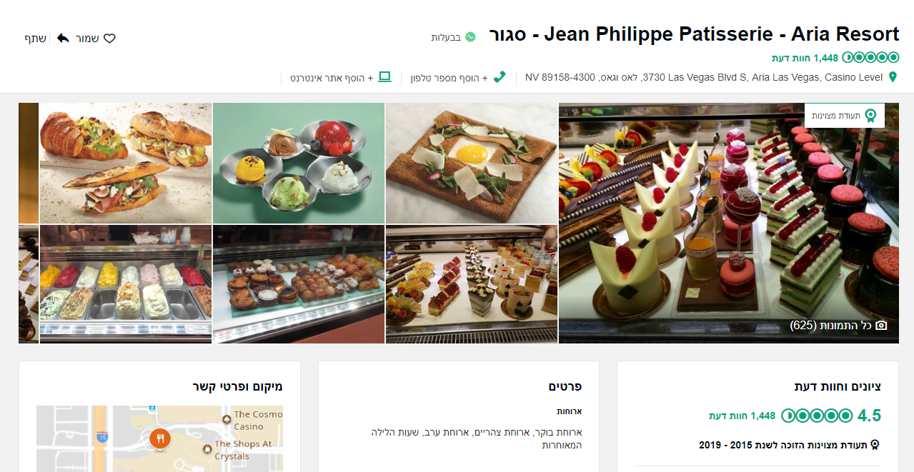

Slide 16
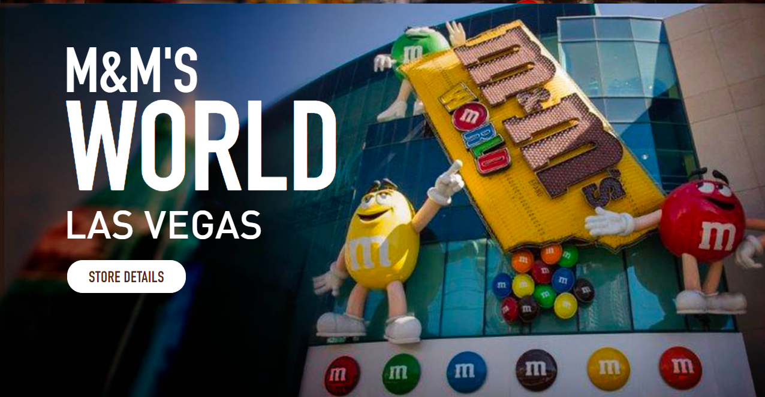
LAS VEGAS This 28,000 square foot, four-level monument to the colorful fun of M&M'S was the first M&M'S World store location ever. In just 2 minutes, guests can create their very own one-of-a-kind M&M'S with the personal printer, combining customized messages, a variety of images, and 16 different colors of M&M'S candies. There are 14 iconic Las Vegas images available for the personalized printer, including the "Welcome to Las Vegas" sign, a deck of cards, wedding bells, and champagne. And be sure to race over to get an up-close look at a replica of Kyle Busch's 18 M&M'S sponsored NASCAR, along with tons of colorful M&M’S Racing merchandise.

Slide 17
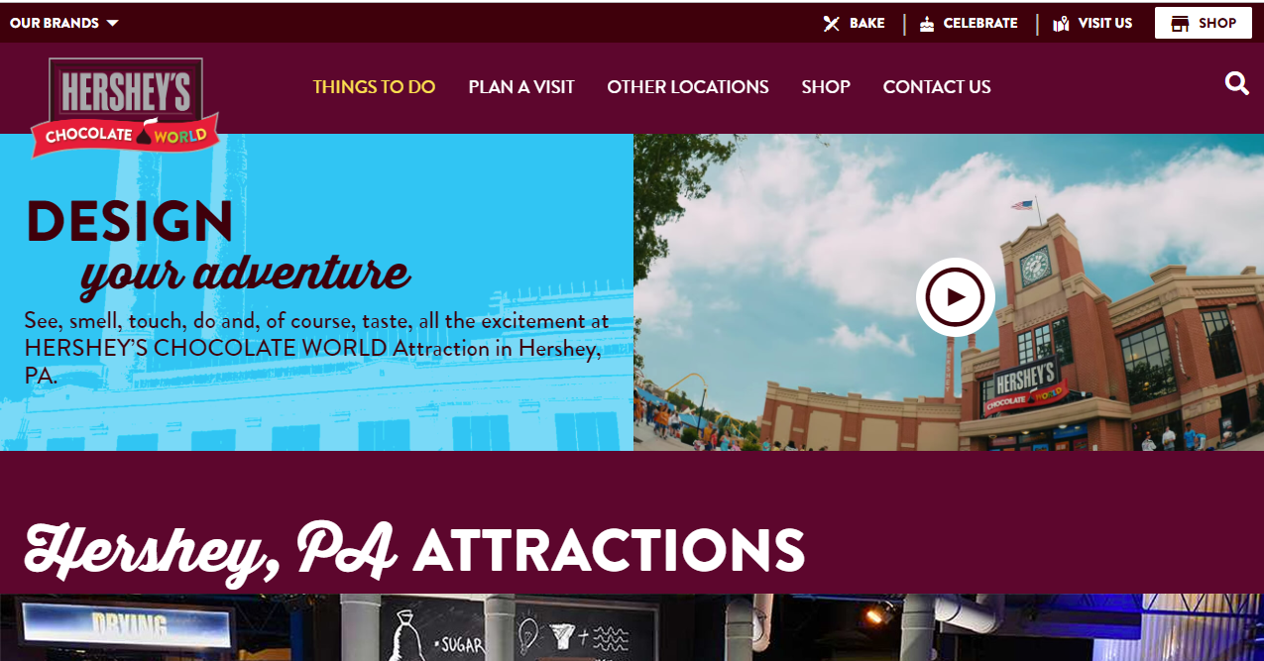
DESIGN your adventure See, smell, touch, do and, of course, taste, all the excitement at HERSHEY’S CHOCOLATE WORLD Attraction in Hershey, PA.

Slide 18
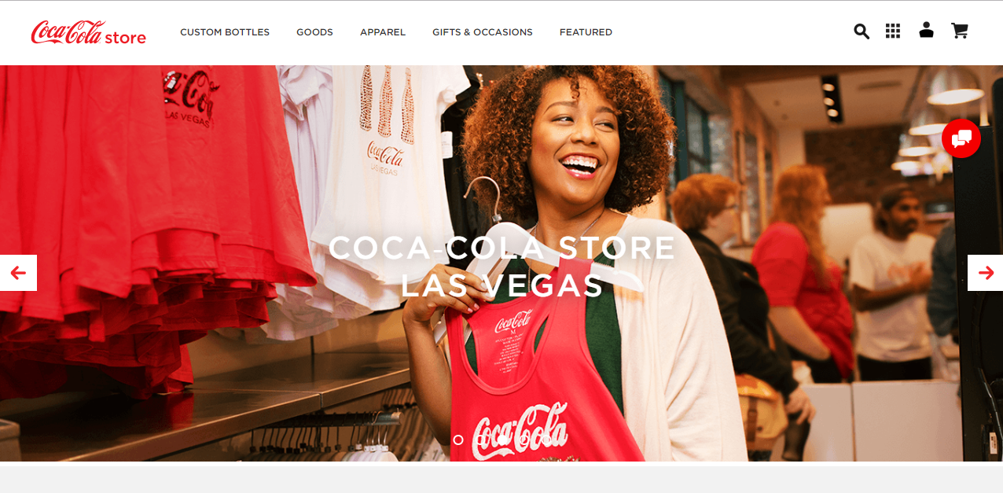
WELCOME TO COCA‑COLA STORE LAS VEGAS! Make Coca‑Cola Store part of your Las Vegas adventure! Experience the world’s most iconic beverage brand in an immersive retail destination including exclusive Coca‑Cola branded merchandise, unique and entertaining experiences and true refreshment that inspires the senses.

Slide 19
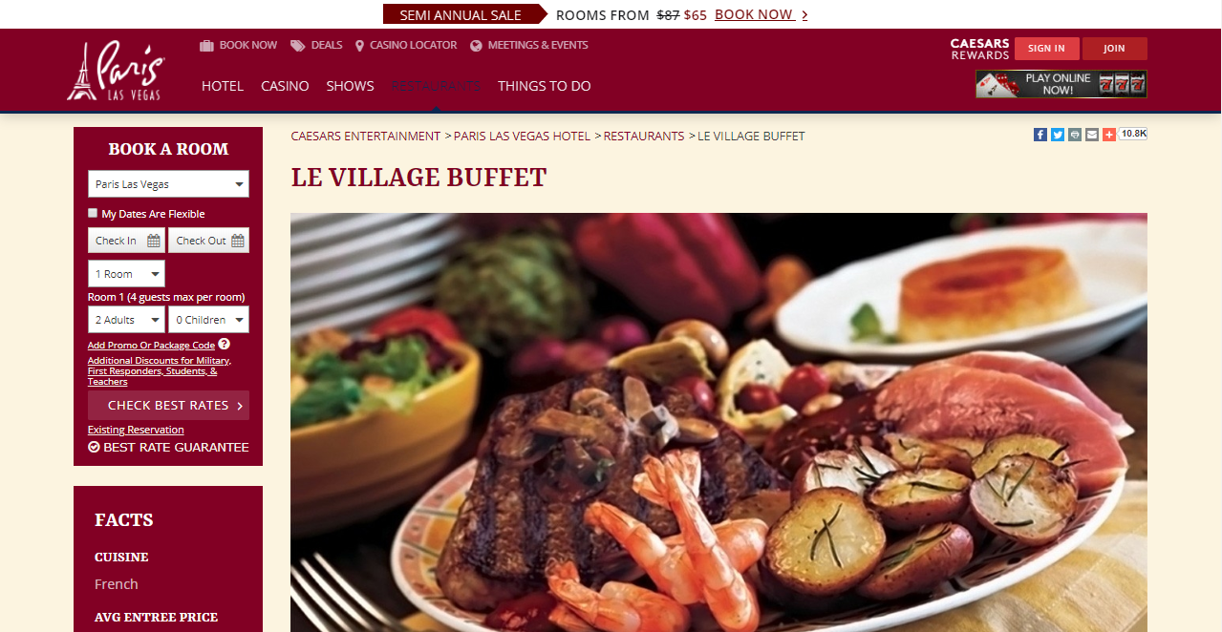
A departure from the traditional expectation, Las Vegas buffet dining is taken to a higher echelon at Le Village Buffet. The incredible French village setting is highlighted by live-action stations and food cooked to order. From the chefs' culinary expertise, Le Village Buffet brings to life the five provinces of France for a dynamic, multi-flavored meal. It’s also the only buffet in town to offer reservations on OpenTable. The buffet features traditional dishes from each province. There's penne alla puttanesca from Provence. Homemade Yukon gold mashed potatoes and rotisserie chicken are inspired by Burgundy. And a selection of signature savory crepes are a nod to Brittany

Slide 20
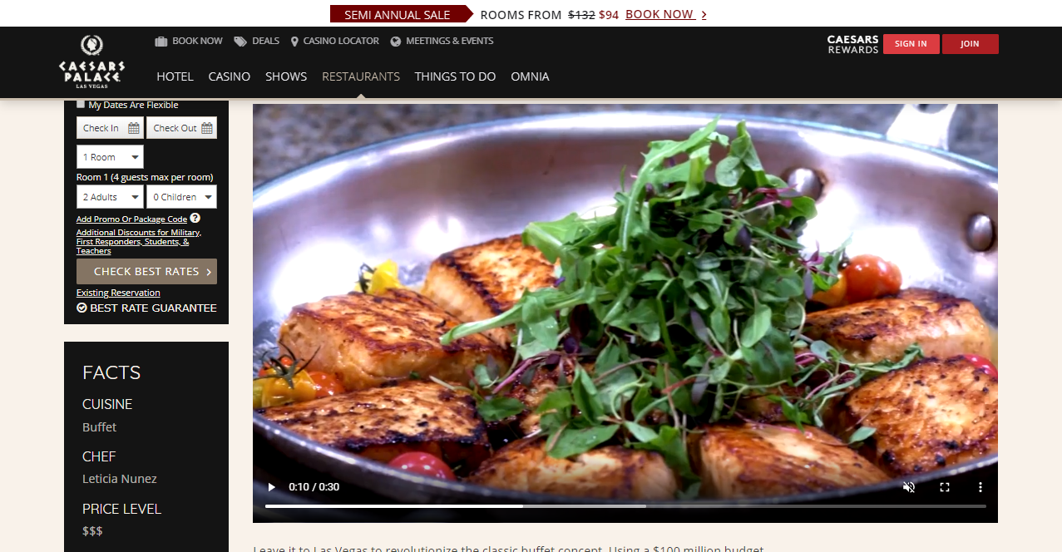
Leave it to Las Vegas to revolutionize the classic buffet concept. Using a $100 million budget, Bacchanal completely reinvented the traditional buffet in 2012, with modern food presentations and an upscale setting. Now that it's been voted Best Buffet in Las Vegas by "USA Today" (more than once), the fever has caught on. Feast your eyes on the succulent presentations from your seat in the air, water, or wood-themed section of the dining rooms. Choose from hundreds of daily offerings, with many dishes uniquely displayed on small plates. Bacchanal Buffet's team of specialized chefs oversees the preparation of the majority of the food in front of the guests while cohesively working to present nine distinct restaurants in one location. Approximately 15 daily chef's specials are added to the menu and they change depending on products, season and the chef's whims.

Slide 21
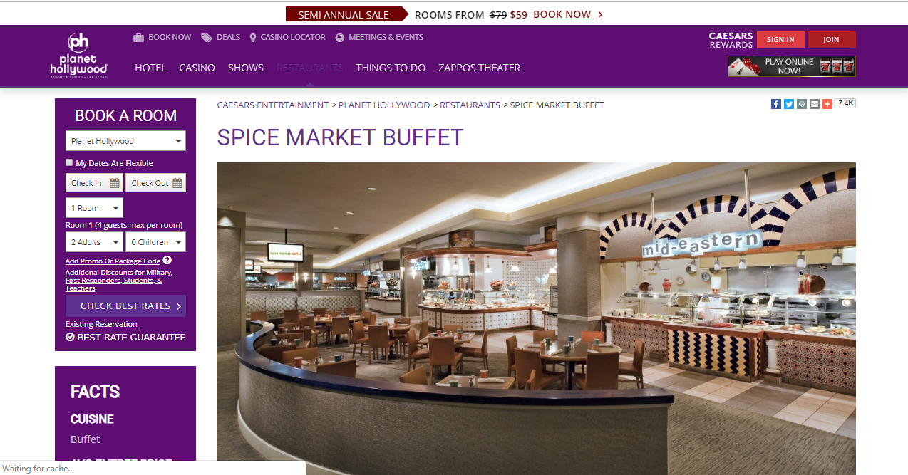
Planet Hollywood's Spice Market Buffet features fare from around the world. If you and your entourage can't decide on a cuisine, this Las Vegas buffet makes it easy. From Mexican and Italian to Asian and American, pile your plates high and go back for seconds - possibly thirds. This Vegas buffet also features an extensive Middle Eastern/Mediterranean section. Vegetarians can enjoy hummus, grilled vegetables, and a full salad bar. End with tantalizing desserts, like cotton candy, sugar free cakes and cookies. For Sunday brunch, enjoy a glass of champagne or mimosa. The restaurant includes movie posters with food-related titles. Keep your eyes peeled for fun ones like "Breakfast at Tiffany's," "Attack of the Killer Tomatoes" and more.

Slide 22
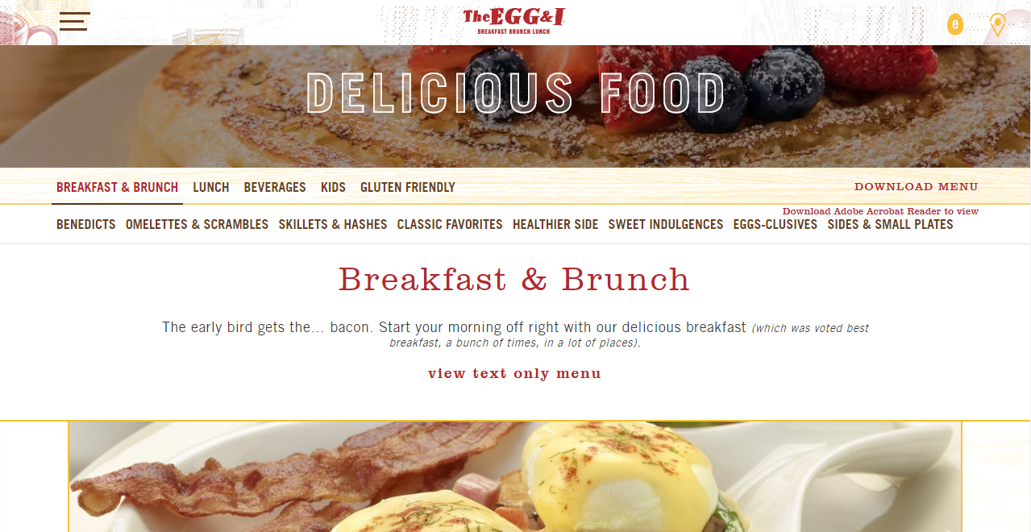
Our Story our commitment to provide friendly service and delicious breakfast, brunch and lunch remains the same. Whether it’s roasting our vegetables in-house, slicing and juicing the season’s freshest fruit or whipping up our French toast batter from scratch, we take pride in the details that we hope will make your visit memorable. Our coffee is brewed fresh and we make everything to order, so you can have it just the way you like it. It’s our way of saying thank you. So sit back, relax and wake up to something wonderful.

Slide 23
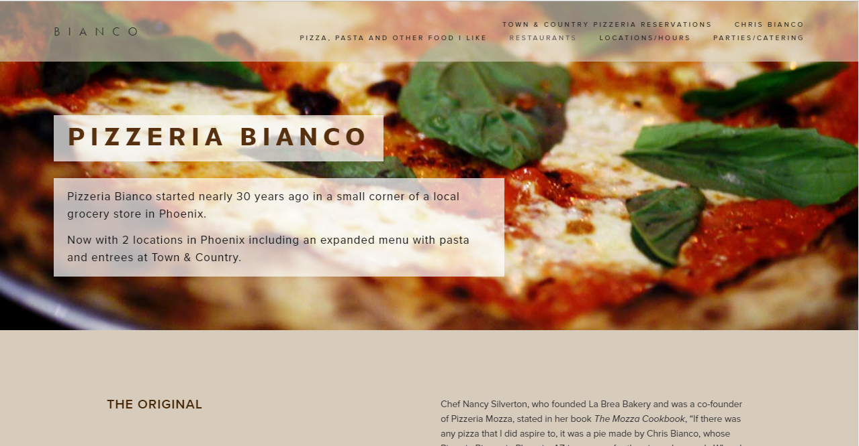
Pizzeria Bianco started nearly 30 years ago in a small corner of a local grocery store in Phoenix. The New York Times call the pizza “perhaps the best in America” (“The Road to Pizza Nirvana goes through Phoenix”, NYT, July 2004.) Rachael Ray declared Pizzeria Bianco the winner of her Pizza Madness Bracket, a contest of pizzerias across the nation in 2010. Food & Wine has labeled Chris’ pizza as “arguably the best pizza in America” (June 2005, June 2009) Zagat named Chris as one of the 6 chefs who changed pizza

Slide 24
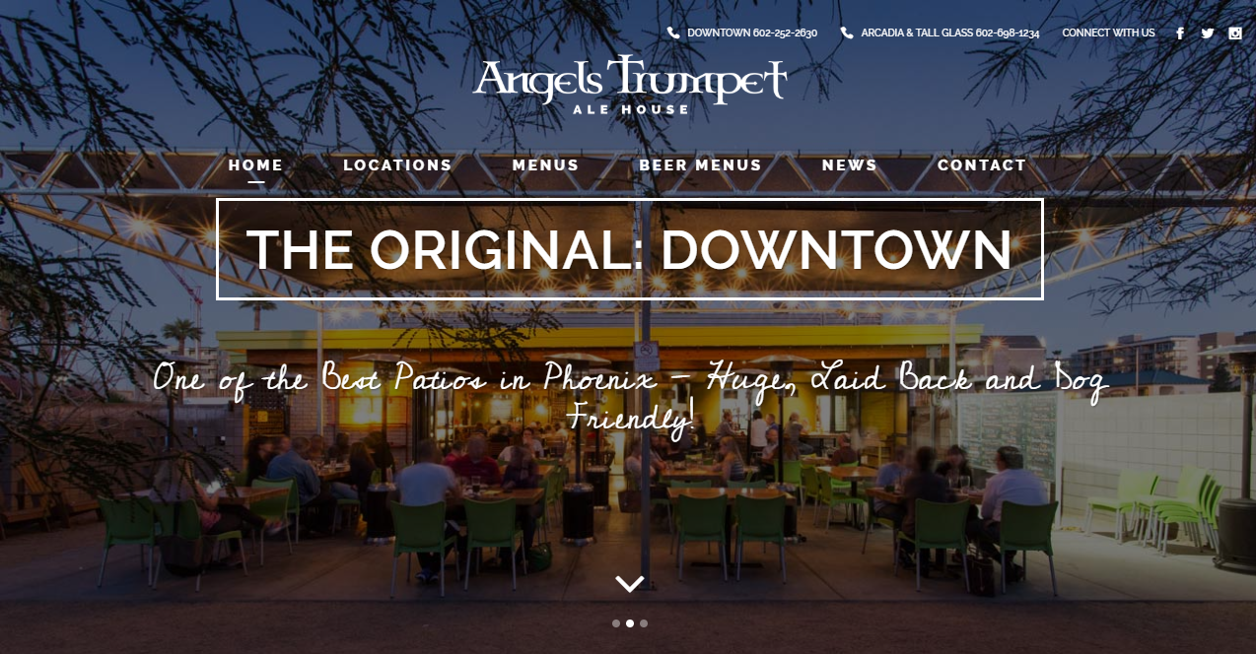
We built the restaurant around the beer cooler because that’s how we like to do things. Our Direct Draw system ensures that there’s no more than 6 feet of line between the keg and your glass. And If you’re as obsessive about your beer as we are, you’ll agree with our commitment to try and never put the same beer on the same tap twice.

Slide 25
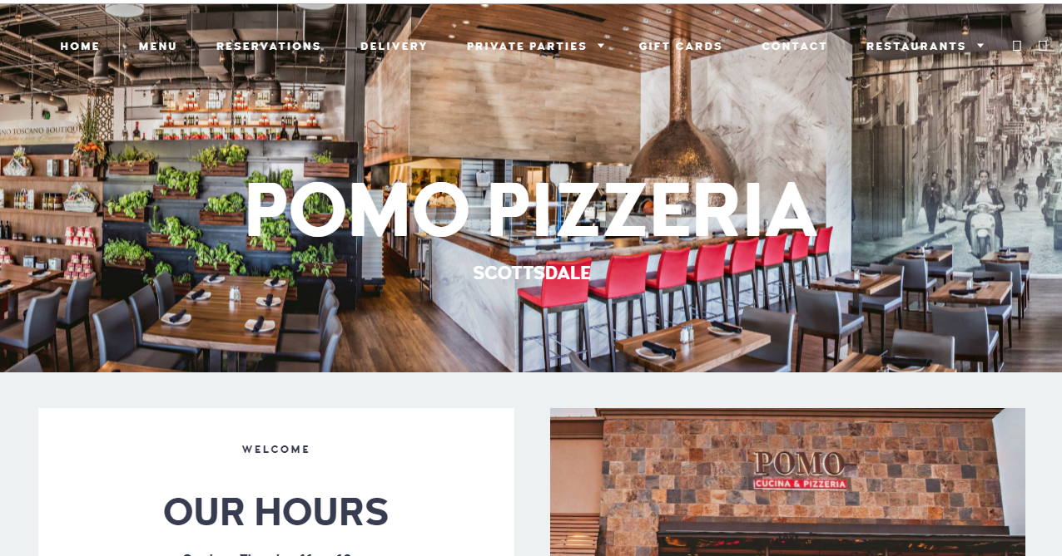
AUTHENTIC ITALIAN PIZERIA NAPOLETANA

Slide 26
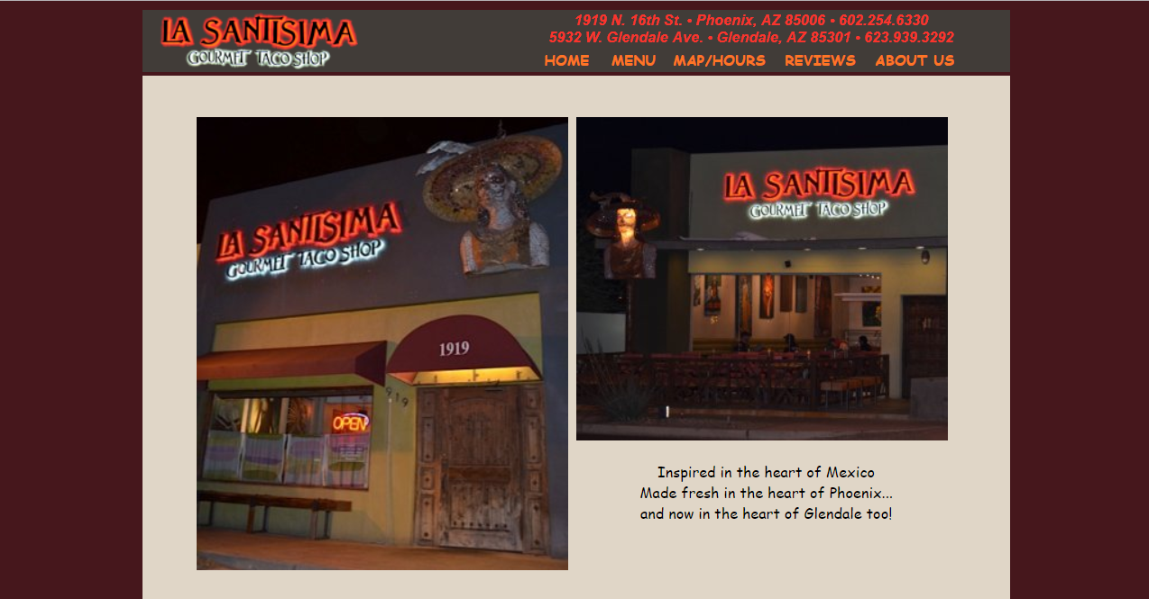
Our aim is to deliver everything that is exciting and fresh about Mexican cuisine to the people of Arizona, banishing old perceptions of heavy, greasy, taste bud-searing, so-called "Tex-Mex." From the beaches of Baja and Cancun to the mountains of the Sierra Madre, Mexico has an incredible variety of fresh and vibrant flavors to offer. All of this results in rich, delicious burritos, tacos and quesadillas. We enjoy Mexican flavors with a dash of our family's own special character. We combine fresh local produce from farms with unique flavors of chipotle chiles, bright green tomatillos, soft Oaxacan cheese, and pillowy flour and corn tortillas from Mexico. We love this food and believe that you will too.

Slide 27
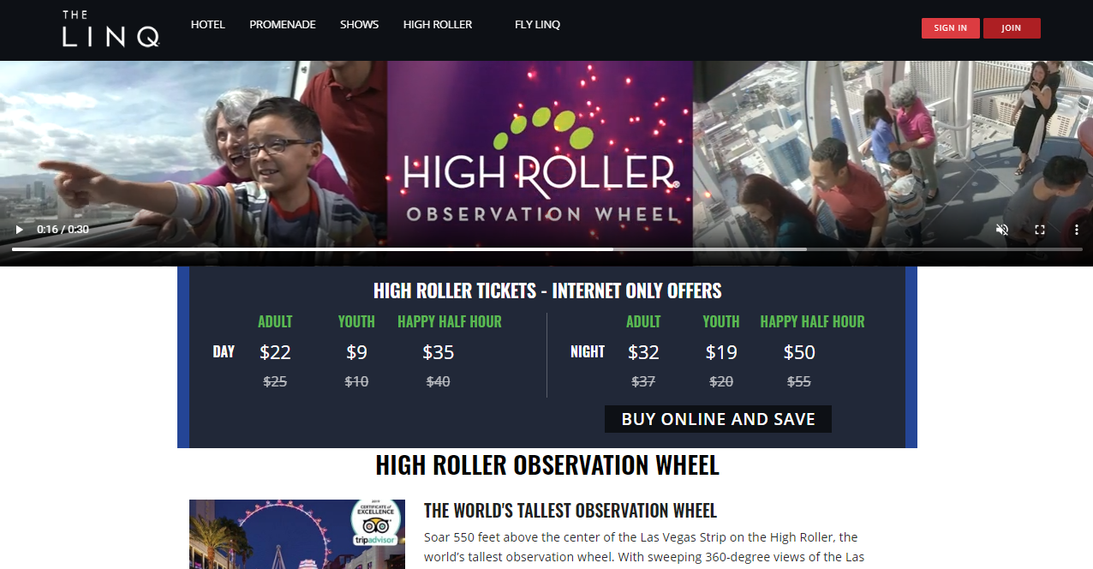
THE WORLD'S TALLEST OBSERVATION WHEEL Soar 550 feet above the center of the Las Vegas Strip on the High Roller, the world’s tallest observation wheel. With sweeping 360-degree views of the Las Vegas Valley and The Strip, the wheel takes 30 minutes to complete one revolution and features 28 spacious cabins to accommodate guests. Stop by the Total Snapshot kiosk to purchase a commemorative photo of your High Roller experience. It’s a perfect keepsake for an unforgettable moment.

Slide 28
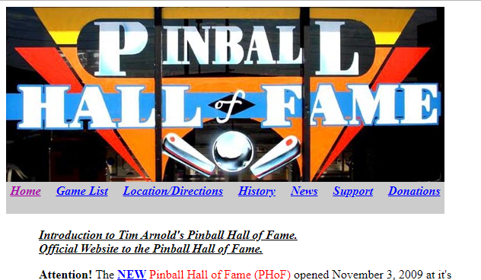
The Pinball Hall of Fame is an attempt by the members of the Las Vegas Pinball Collectors Club to house and display the world's largest pinball collection, open to the public. A not-for-profit corporation was established to further this cause. The games belong to one club member (Tim Arnold), and range from 1950s up to 1990s pinball machines. Since it is a non-profit museum, older games from the 1960s, 1970s and 1980s are the prevelant, as this was the 'heyday' of pinball. There are no 'ticket spitters' here (aka kiddie casinos or redemption). It's all pure pinball (and a few arcade novelty games) from the past. And since it's a non-profit, excess revenues go to non-denominational charities.

Slide 29
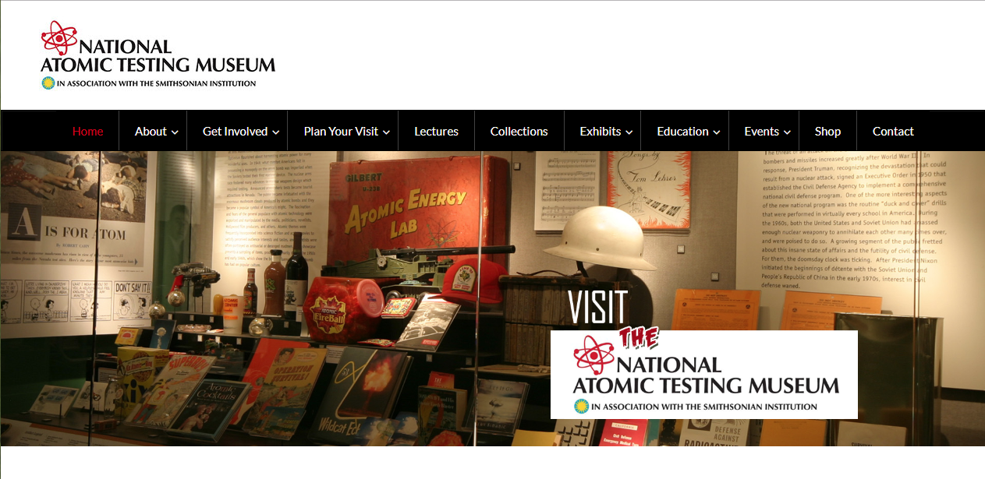
The National Atomic Testing Museum (NATM) is a national science, history and educational institution that tells the story of America’s nuclear weapons testing program at the Nevada Test Site. The Museum uses lessons of the past and present to better understand the extent and effect of nuclear testing on worldwide nuclear deterrence and geo-political history. It provides collection-based exhibits and learning activities for greater public understanding and appreciation of the world in which we live. Its collections and activities are inseparably linked to serve a diverse public of varied ages, backgrounds and knowledge.

Slide 30
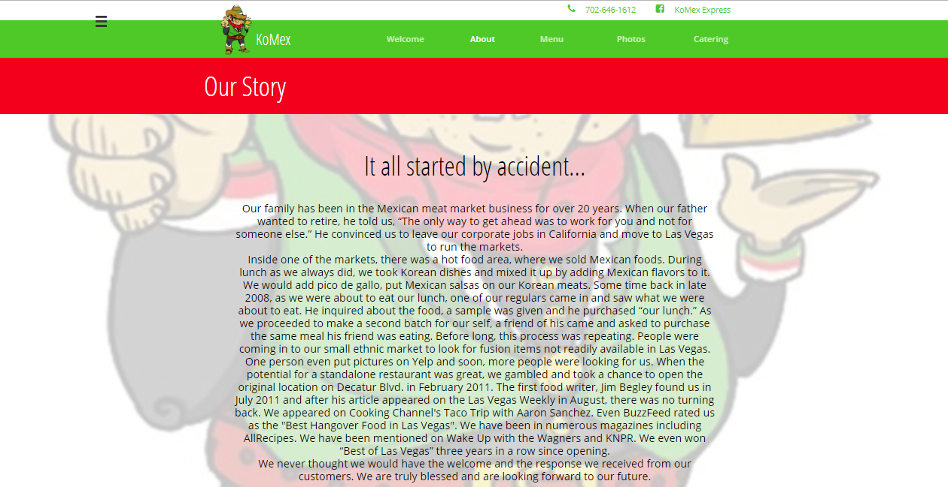
Korean, Mexican, Chinese fusion food. Many of our menu items are Korean Infused. Upscale food quality, BIG portions at small prices. Where else can you go to satisfy different tastes???!!!!

Slide 31
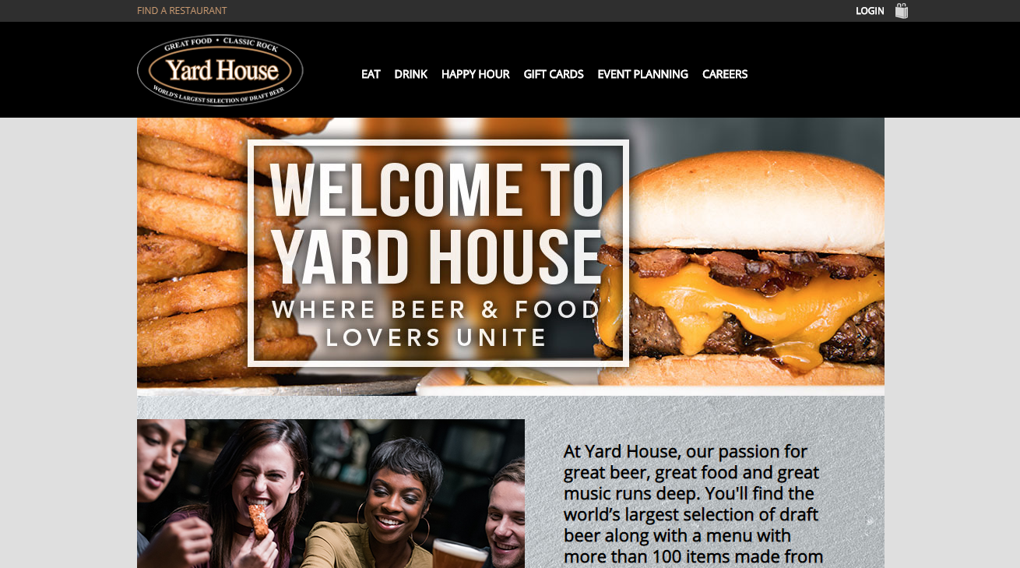
At Yard House, our passion for great beer, great food and great music runs deep. You'll find the world’s largest selection of draft beer along with a menu with more than 100 items made from scratch daily

Slide 32
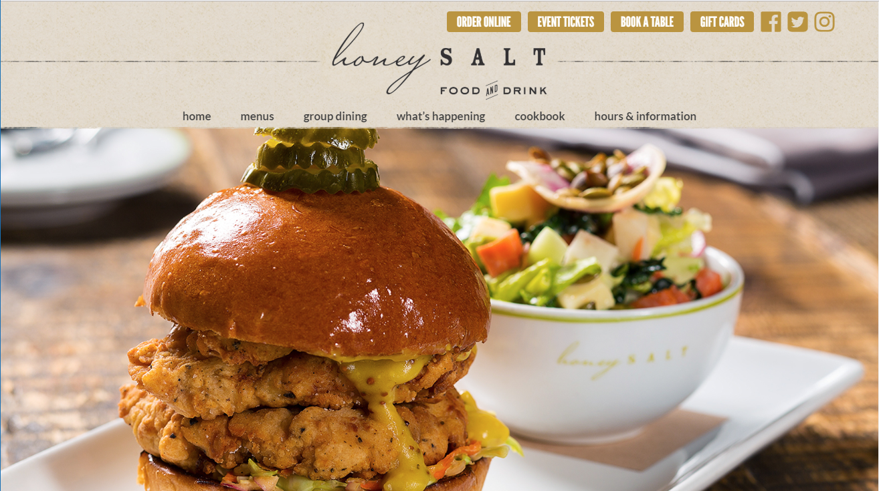
WELCOME TO HONEY SALT! Home is where the heart and food is, and we all have special moments with family and friends which have happened at a dinner table. Honey Salt is one of the prominent Las Vegas restaurants and wants to provide you with an ambiance of community and family with food to feed your soul. Whether you’re a Summerlin local looking for the best brunch in Las Vegas or visiting the greater Las Vegas area and seeking a fresh, farm to table restaurant, let us welcome you to Honey Salt. Our farm-to-table restaurant in Las Vegas offers you home comforts with quality ingredients. We worked vigorously to build a menu of classics and excitingly present them. You will feel you are back home with every bite you take.

Slide 33
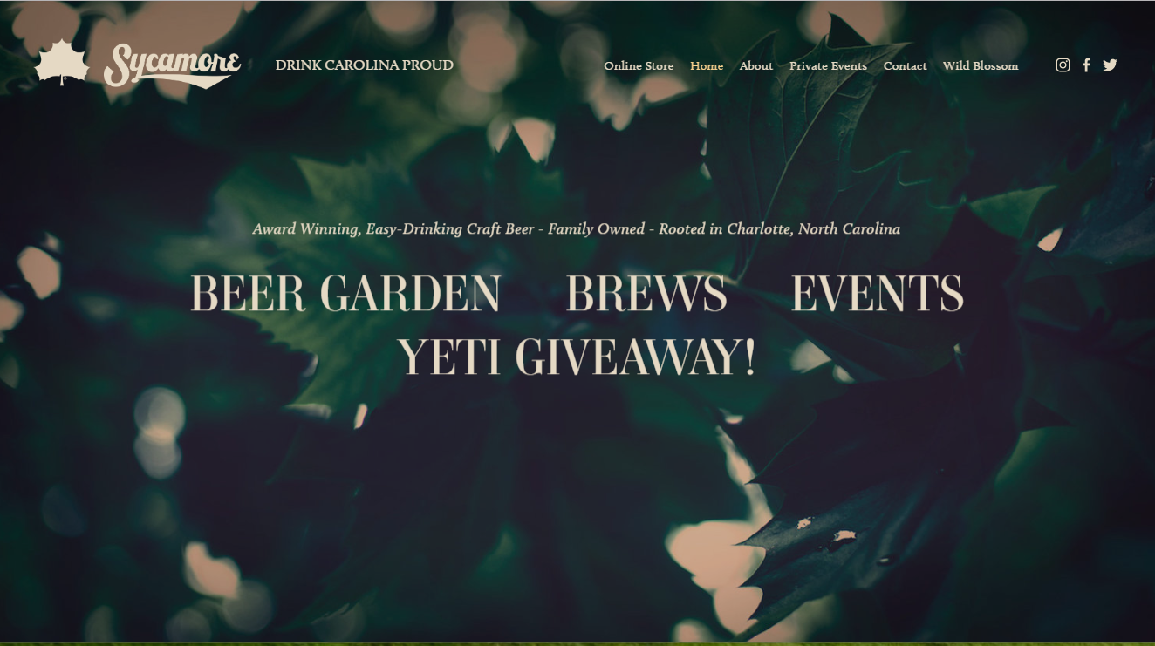
THE FRESHEST INGREDIENTS POSSIBLE ALL-NATURAL, EXTRAORDINARILY TASTY CRAFT BEER At Sycamore Brewing, we believe fresh beer made with top-notch ingredients should be enjoyed by everyone. So, a few years back, with proud roots in Charlotte, we set out to brew beers that bring people together and drink easy from the first sip to the last. After humbly perfecting some of our favorite recipes over the last decade, we’re honored to share them with you. If you like exceptionally fresh, tasty beer, we invite you to gather a few friends and neighbors and enjoy a pint of Sycamore.

Slide 34
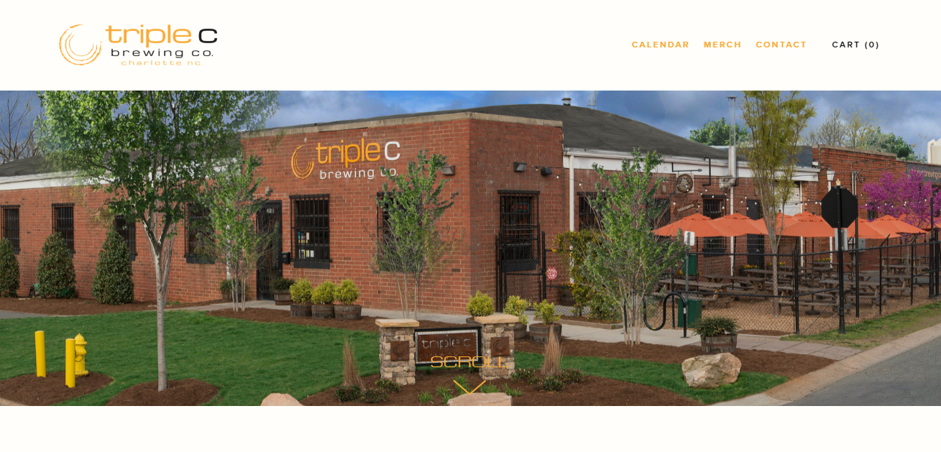
Our ubiquitous three C’s now represent the core beliefs of the brewery craft, community, and commitment to the environment. From an easy drinking blonde ale to a boozy barrel-aged stout we make sure we have something for everyone on our tap list. We’ve even won two bronze medals for our 3C IPA(2015), and Zest-A-Peel(2018) at the Great American Beer Festival. Our brewery operates a 15 barrel brew system in our main brewhouse and a 7 barrel brew system in our barrel room as well as two, (15 barrel capacity) foeders. Giving back to our community and cultivating events that bring people together are also incredibly important to us. We love to celebrate and support our South End neighborhood.

Slide 35
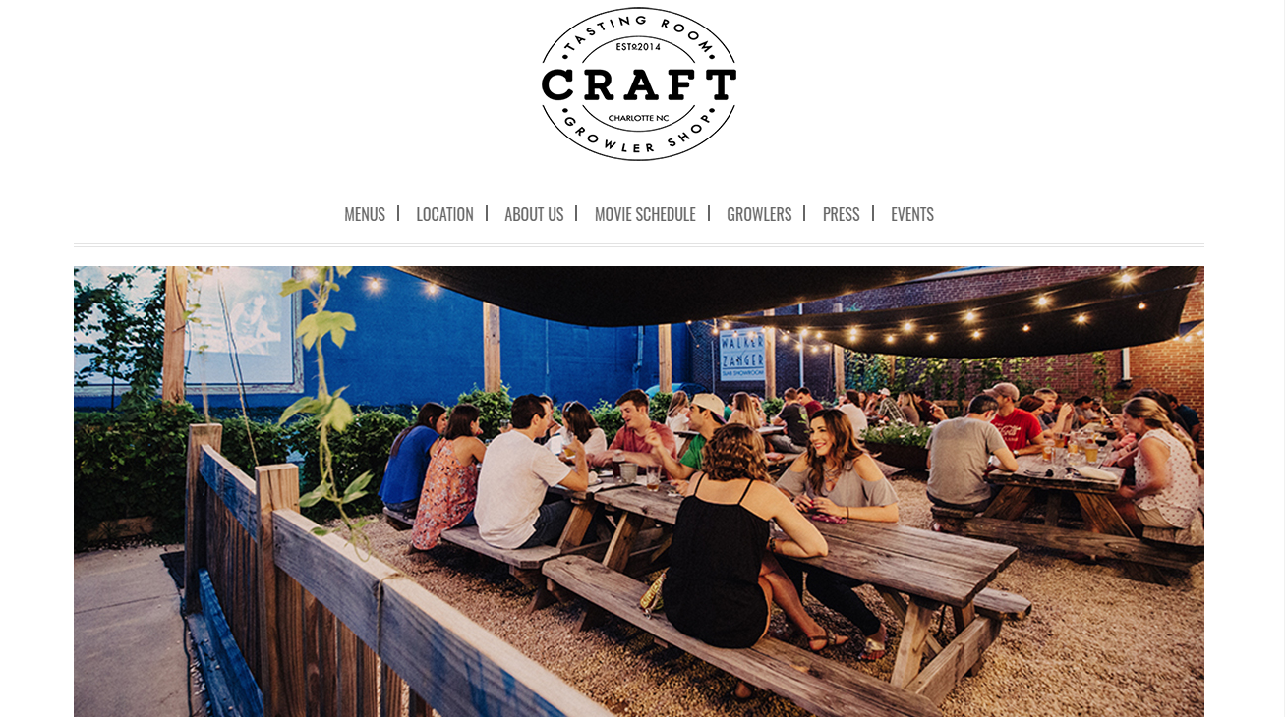
With a shared love of simple good food and craft beer, husband /wife team Alyson and Dan Davis opened Craft Tasting Room and Growler Shop in 2014 in the Gold District of Charlotte’s South End with the idea to create a warm and inviting place to enjoy local craft beer, artisanal regional cheeses and charcuterie. Originally from Tennessee, after 12 years working in NYC’s fast-paced culinary and fashion industries the couple moved to Charlotte to raise their growing family. Dan is a chef and craft beer enthusiast who has trained under some of the world’s most esteemed chefs.

Slide 36
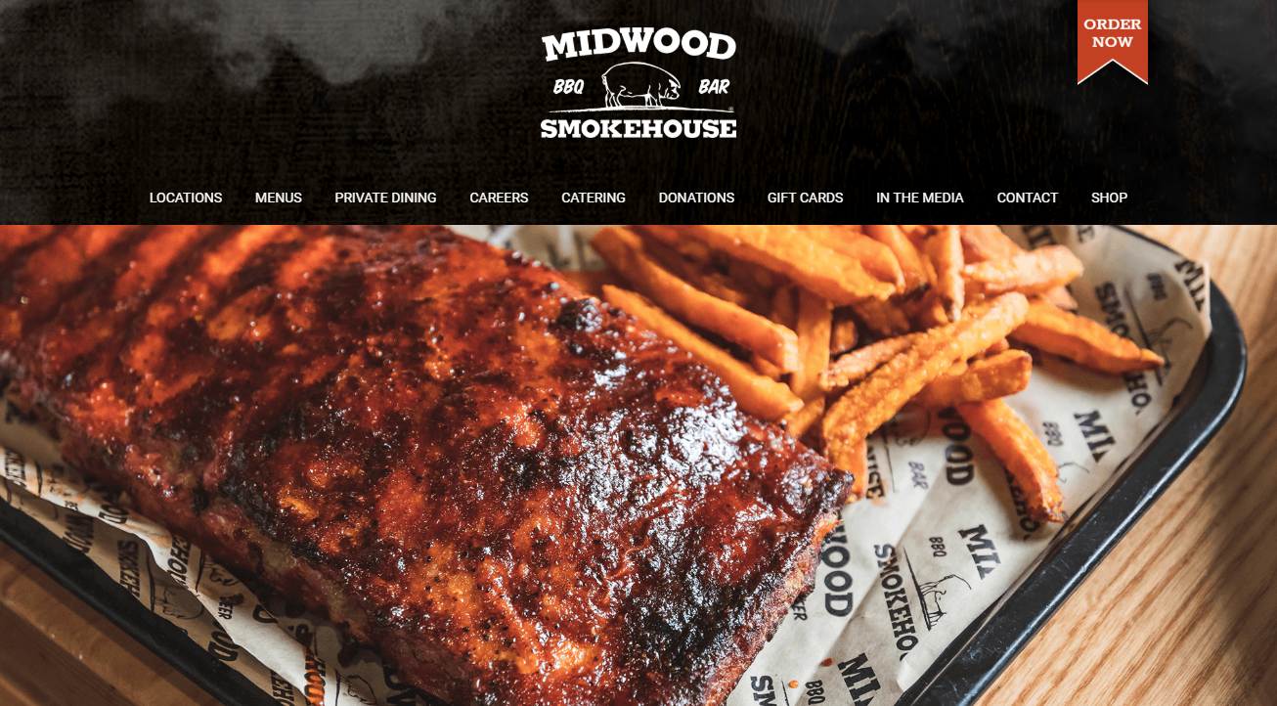
We're your neighborhood smokehouse using nothing but NC hickory hard wood and hard work to make the best barbecue around.

Slide 37
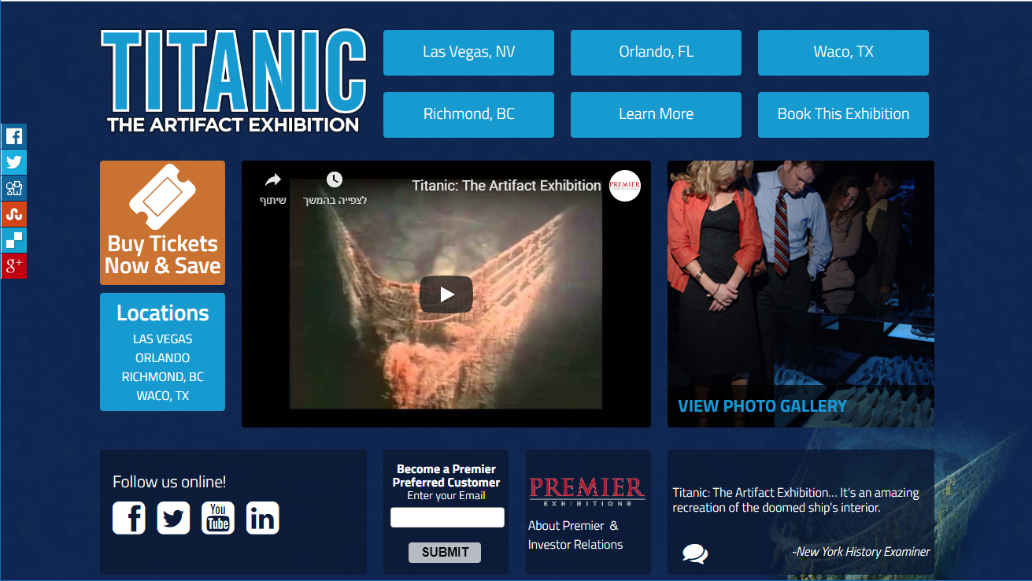
The 25,000-square-foot exhibit features numerous items from the Titanic, including luggage, the ship's whistles, floor tiles from the first-class smoking room, a window frame from the Verandah Cafe and an unopened bottle of champagne with a 1900 vintage. In addition, the exhibit features a piece of Titanic’s hull, a full-scale re-creation of the Grand Staircase as well as a newly expanded outer Promenade Deck, complete with the frigid temperatures felt on that fateful April night. These actual artifacts, recovered from two and one half miles below the surface of the North Atlantic, tell the story behind the legendary Titanic’s short journey from construction and destruction to eventual recovery. Walk her decks, peer into her cabins and meet her passengers and crew.

Slide 38

Shark Reef Aquarium at Mandalay Bay is not your typical aquarium. It's a total sensory experience designed to transport visitors to an undersea ocean of fantastic sights, sounds and encounters. Featuring dangerous and unusual aquatic animals from the world's tropical waters, Shark Reef Aquarium takes visitors on a journey through an ancient temple slowly being claimed by the sea. Fourteen breathtaking exhibits are devoted to dangerous aquatic predators. The largest exhibit is the 1.3 million gallon shipwreck where visitors experience an almost 360-degree view, teeming with sharks and fish, through an acrylic tunnel. The Touch Pool is a popular attraction, where guests can touch an ever-changing collection of animals including sharks, rays or horseshoe crabs. More than 2,000 animals are displayed at Shark Reef Aquarium, over 100 different species and featuring 15 species of sharks.

Slide 39
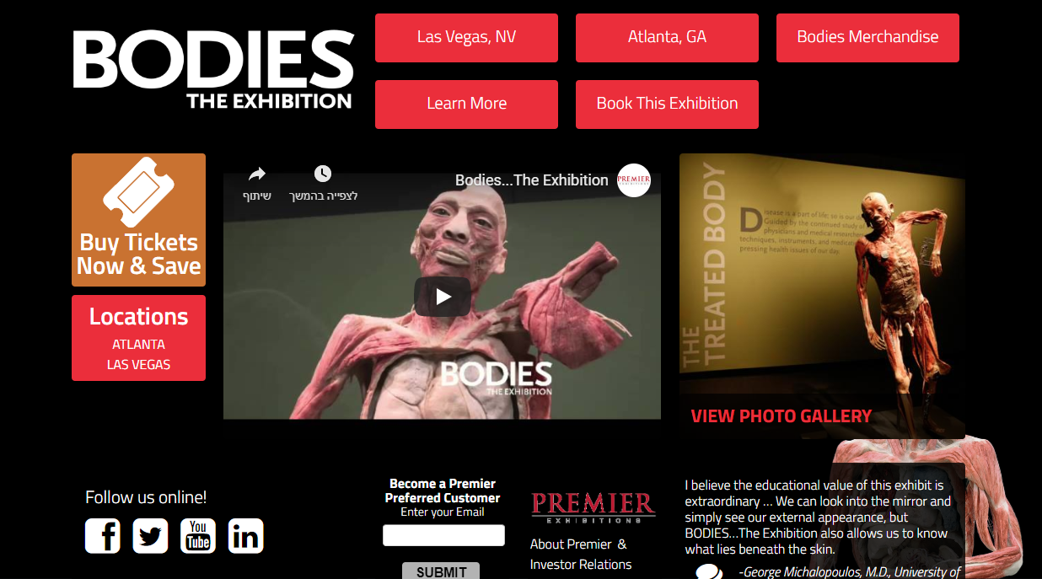
BODIES...The Exhibition offers an intimate and informative view into the human body. Using an innovative preservation process, the Exhibition allows visitors to see the human body's inner beauty in educational and awe-inspiring ways. Our Exhibitions have over 200 actual human bodies and specimens meticulously dissected and respectfully displayed, offering an unprecedented and wholly unique view into the amazing body. Look deep inside the systems of the human body: Skeletal, muscular, nervous, respiratory, digestive, urinary, reproductive, endocrine, and circulatory. Come explore, experience, and celebrate the wonder of the human form.

Slide 40
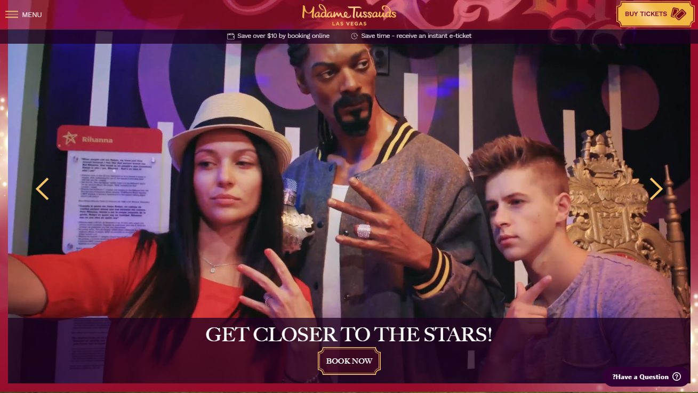
At a wax attraction, you’re not just taking a selfie with a pop star. You’re practicing your DJ skills with Steve Aoki at the turn tables in a true Vegas nightclub experience (fog, lasers and banging club hits included!). You’re not just snapping pics with Marvel Super Heroes. You’re fighting the bad guys alongside your Marvel faves in an interactive, next level 4D experience. And that’s what Madame Tussauds is - a wax attraction, not a wax museum.

